Slide 1
What Do Novelists Write About?
Nicholas Halpern
March 2017

Slide 2
objectives
What topics do novelists write about?
Does the frequency of each topic change over time?
Are novels reflective of life at the time they are written, or are they a form of escapism?

Slide 3
Data sources
Project Gutenberg
English Text Files (41,639)
Wikipedia
List of Novelists (6,782)
retrieve from mirror site
web scrape
Candidate Novels (5,458)
web scrape
Wikipedia
Book Publication Date
Google Search
Book Publication Date
web scrape
Book Texts and Dates (1,935)

Slide 4
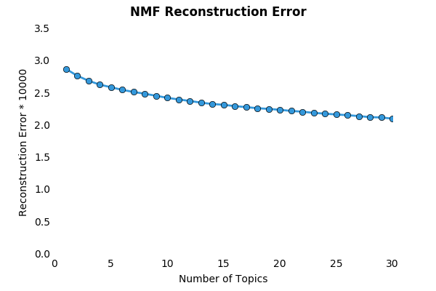
How many topics are there?

Slide 5





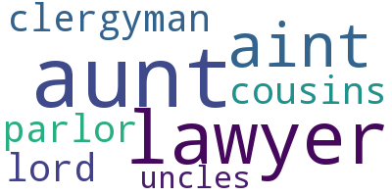
















How many topics are there?
Four Topics
Five Topics
Six Topics
Seven Topics

Slide 6
How many topics are there?
Four Topics
Five Topics
Six Topics
Seven Topics
87%
85%
35%
87%
62%
99%
94%
99%
89%
62%
54%
36%
90%
78%
69%
93%
50%
30%

Slide 7
What are the Five topics?

Slide 8
What are the five topics?
Pride and Prejudice
David Copperfield
The Beautiful and Damned
The Jungle
Redgauntlet
Ivanhoe, A Romance
Gulliver’s Travels
Moby Dick
The Call of the Wild
The Ranch at the Wolverine

Slide 9
“give me”
give me thy good word
give me a dagger
give me twenty dollars
give me back my gold piece
give me your confidence
give me pure water
give me a roll of dried ferns
give me the sugar
give me that bottle
give me their plans

Slide 10
“The man”
the man of erudition
the man she adores
the man looked sympathetic
the man looked stern
the man prepared for daring deeds
the man with wizard’s attributes
the man fled, and lied, and swore less
the man fell with a large army
the man who had died recently
the man yonder leadin’ his horse

Slide 11
“She Said”
she said in a few verses written two years ago
she said loftily “and now I wish to be worth thirty thousand”
she said she pitied him, forever widowed
she said at length, leading the way to the oaks
she said with passion, “listen, they will be of a wreck”
she said humbly, how broad his shoulders were
she said sweetly from the atlantic ocean
she said with the revolver
she said and kissed me on my side
she said she had seen the poor devil go to pieces
she said pitifully
she said I was there to bring back gold for you
she said in wonderment, “heaven guard us!”
she said it was terror that dominated her
she said to his full six feet of height
she said nothing, of course
she said no shepherd sought her

Slide 12
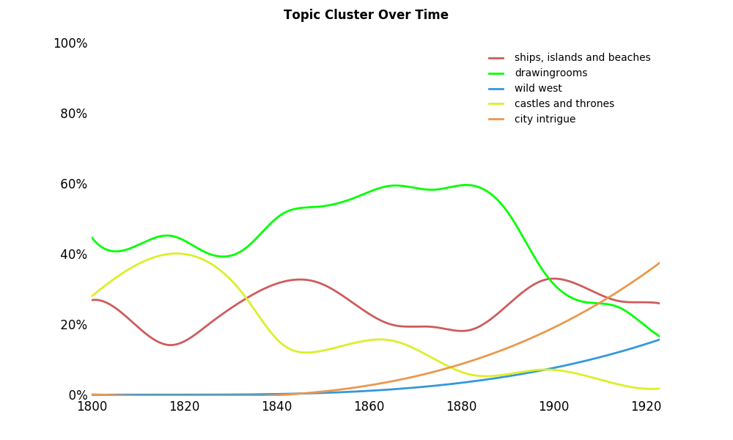
frequency of topics over time

Slide 13
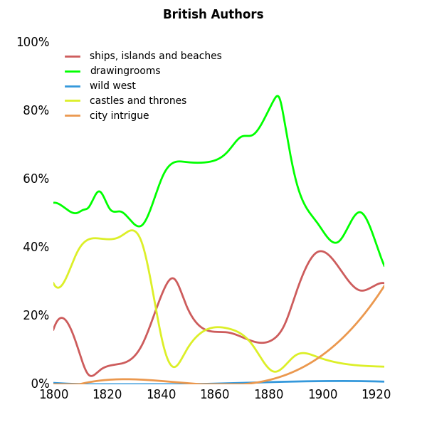
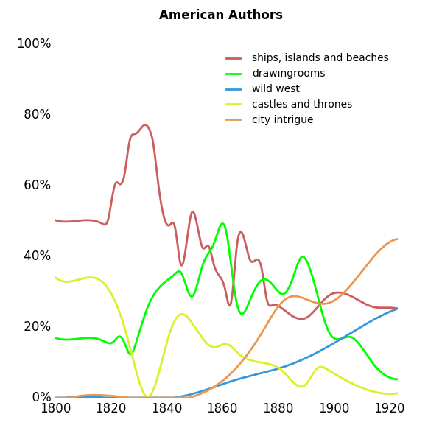
topic cluster by nationality

Slide 14
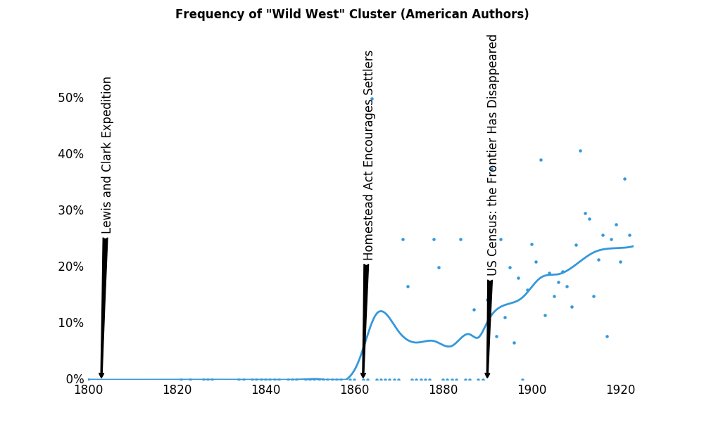
do novels reflect the events of the period?

Slide 15
next steps
Extend analysis to:
A sampling of non-off-copyright books
Magazine stories
Novels in languages other than English

Slide 16
Appendix

Slide 17
Bibliography
Project Gutenberg. (n.d.). Retrieved March 14, 2017, from www.gutenberg.org.

Slide 18
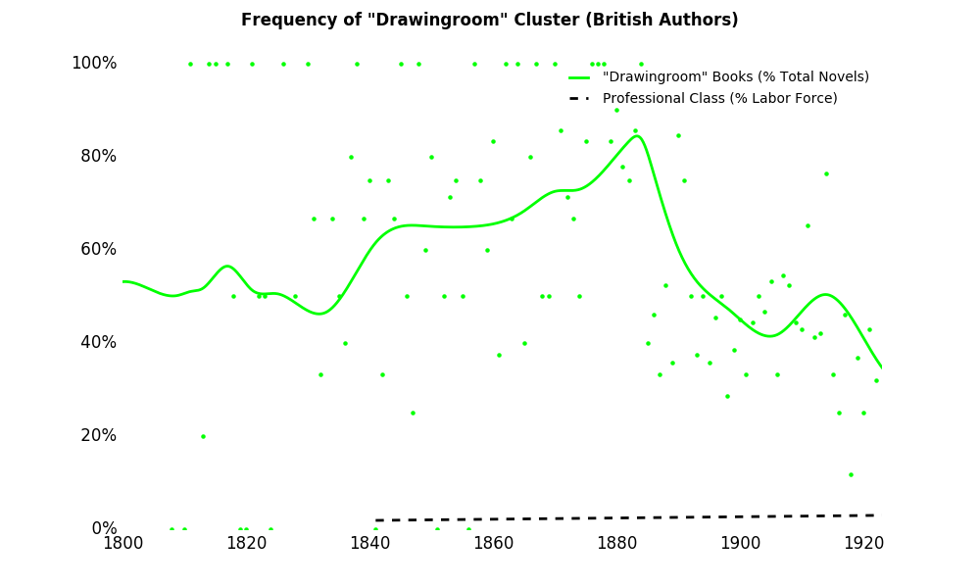
do novels reflect the events of the period?

Slide 19
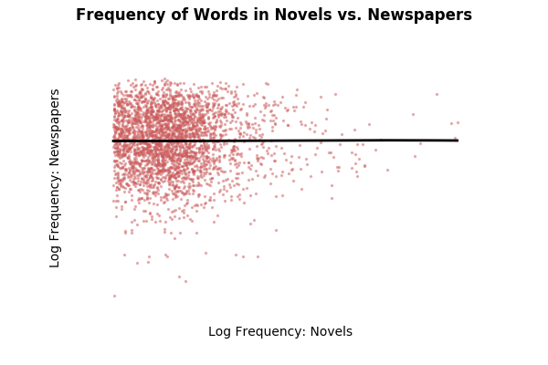
do novels reflect the events of the period?

Slide 20
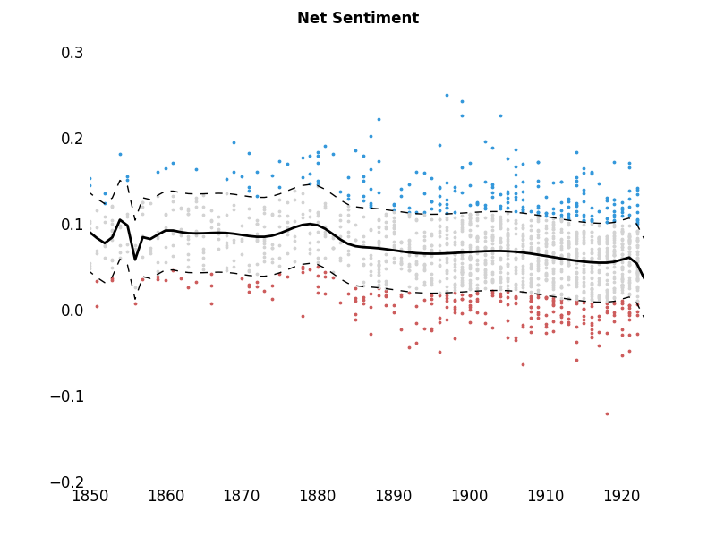

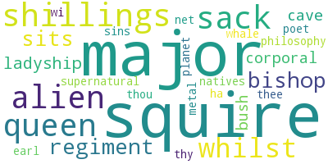
Sentiment analysis

Slide 21
What are the five topics?

Slide 22
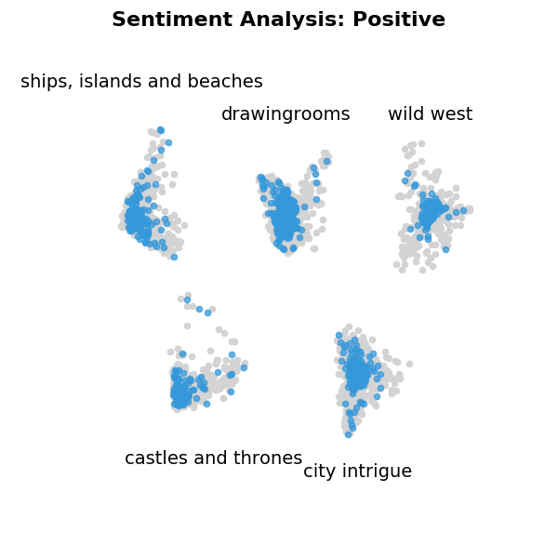
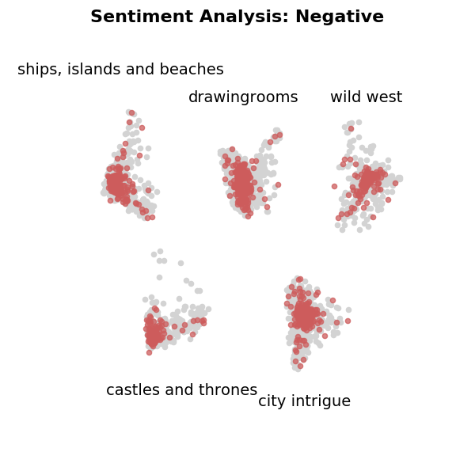
Sentiment analysis

